Slide 1
Enterprise Apps & Agents
POWER PLATFORM
Enterprise Code App → Dataverse → AI Builder → Copilot Studio Agent → Governed Automation → Capstone Project

Slide 2
Dataverse
Power Apps Code Apps
Microsoft Dataverse is a cloud-based, low-code data platform built into the Microsoft Power Platform

Slide 3
05
Connect to data sources
05
Choose the right integration path for each business capability.
Dataverse
SharePoint
Power Automate
Structured business data, relationships, security roles, and environment-aware solutions.
Document libraries, lists, and collaboration scenarios.
Approvals, notifications, scheduled work, and process orchestration.
External APIs
Environment variables
Custom connectors
Use supported connectors or a secured API layer; define timeouts and error handling.
Keep environment-specific endpoints and configuration outside source code.
Expose approved APIs through governed, reusable integration contracts.
Before implementation: confirm connector availability, authentication mode, permissions, and data-loss-prevention policies.

Slide 4




Let’s talk about data
Analyze
Power BI
Know
Act
Automate
Power Apps
Automate
AI Builder
Learn

Slide 5
Let’s talk about data
Analyze
Power BI
Know
Act
Automate
Power Apps
Automate
Connectors
AI Builder
Learn

Slide 6

Let’s talk about data
Analyze
Power BI
Know
Act
Automate
Power Apps
Automate
DV
Data Verse
AI Builder
Learn

Slide 7

Two Types of Data. . .
External
Internal

Slide 8
Two Types of Data. . .
Connectors
Data Verse

Slide 9
Why external data (Connectors)?
It’s easy
It’s home

Slide 10
Why internal data - Data verse?
It’s smart
It scales
It’s secure

Slide 11
Benefits of Microsoft Dataverse
1
  Simple to manage – Both the metadata and data are stored in the cloud. You don't need to worry about the details of how they’re stored.
2
  Helps to secure data – Data is stored so that users can see it only if you grant them access.
  Role-based security allows you to control access to tables for different users within your organization.
  Access your Dynamics 365 data – Data from your Dynamics 365 applications is also stored within Dataverse, which allows you to quickly build apps that use your Dynamics 365 data and extend your apps by using Power Apps.
3
4
  Rich metadata – Data types and relationships are used directly within Power Apps.
5
  Logic and validation – Define calculated columns, business rules, workflows, and business process flows to ensure data quality and drive business processes.
6
  Productivity tools – Tables are available within the add-ins for Microsoft Excel to increase productivity and ensure data accessibility.
Notes:
Whether you are building a canvas app or a model-driven app, Dataverse is the ideal data source because it is the foundational data source of Microsoft Power Platform. As a result, you will experience the most functionality, the deepest integrations, the most features, and the best ease-of-use of any available data sources. From simple web-based data design to robust, role-based security, Microsoft Dataverse is a straightforward platform that you can use to begin designing your data structures and helping to keep them safe. Then, with your data in place, you have rich integration capabilities from Power Apps and the rest of Microsoft Power Platform. Additionally, by applying business rules, you can trust that your business integrity will be maintained no matter what tool you use to interact with the data.
Another benefit of using Dataverse is that all of your data is stored in tables. A table is a set of records that is used to store data, similar to how a table stores data within a database. Dataverse includes a base set of standard tables that cover typical scenarios, but you can also create custom tables that are specific to your organization. Standard and custom tables within Dataverse help provide a secure and cloud-based storage option for your data. Tables allow you to create a business-focused definition of your organization's data for use within apps.
Some benefits of using Dataverse and its tables include:
Simple to manage - Both the metadata and data are stored in the cloud. You don't need to worry about the details of how they're stored.
Helps to secure data - Data is stored so that users can see it only if you grant them access. Role-based security allows you to control access to tables for different users within your organization.
Access your Dynamics 365 Data - Data from your Dynamics 365 applications is also stored within the Dataverse, which allows you to quickly build apps that use your Dynamics 365 data and extend your apps by using Power Apps.
Rich metadata - Data types and relationships are used directly within Power Apps.
Logic and validation - Define calculated columns, business rules, workflows, and business process flows to ensure data quality and drive business processes.
Productivity tools - Tables are available within the add-ins for Microsoft Excel to increase productivity and ensure data accessibility.

Slide 12
Dataverse Defined
1
  A Dataverse database is a single instance of Microsoft Dataverse which stores data in a set of standard and custom data structures called tables.
2
  A Dataverse database is scalable and supports both large data sets and complex data models.
  The standard table design in a Microsoft Dataverse database is based upon an open data model standard called Common Data Model. The structure of a Microsoft Dataverse database is based upon the definitions and schema in the Common Data Model.
3
4
  Dataverse contains comprehensive business logic, processing, integration, and security features that aid the building of business solutions.
Notes:
A Dataverse database is a single instance of Microsoft Dataverse which stores data in a set of standard and custom data structures called tables. A table is a logical set of rows that is used to store data. Rows within a table contain many columns to manage individual pieces of information about a single row.
You can create one or many database instances in Microsoft Dataverse to host data behind your business solutions. Each instance of a Microsoft Dataverse will start with the same set of tables to store data, but you can always extend and customize a Microsoft Dataverse database to meet specific business needs. This means that you can share business solutions that reference standard tables in Microsoft Dataverse across your organization or with any other organization by using it anywhere in the world.
A Dataverse database supports large data sets and complex data models. Tables can hold millions of items, and you can extend the storage in each instance of a Microsoft Dataverse database to four (4) terabytes per instance. The amount of data that is available in your instance of Microsoft Dataverse is based upon the number and type of licenses that are associated with it. Data storage is pooled between all licensed users, so you can allocate storage as needed for each solution that you build. Additional storage can be purchased if you need more storage than what is offered within standard licensing.
Tip: Dataverse supports transactional multi-user applications, where quick response to user demand is the priority. It is not intended to be a platform for long running or batch processing.
The standard table design in a Microsoft Dataverse database is based upon an open data model standard called Common Data Model. Common Data Model is a logical design that includes a set of open-sourced, standardized, extensible data tables and relationships that Microsoft and its partners have published in an industry-wide initiative called the Open Data Initiative. This collection of predefined tables, columns, semantic metadata, and relationships form the basis of the Common Data Model. The structure of a Microsoft Dataverse database is based upon the definitions and schema in the Common Data Model. The key benefit of using Common Data Model as the basis of a Microsoft Dataverse database is simplified integration of any solutions that use a Common Data Model schema, because the standard tables of the solution are the same. You will also be able to take advantage of a rich ecosystem of solutions that vendors have built from using Common Data Model. Best of all, there is practically no limit to how far you can extend a Microsoft Dataverse database.
Dataverse contains comprehensive business logic, processing, integration, and security features that aid the building of business solutions. These features are covered later in the course.

Slide 13
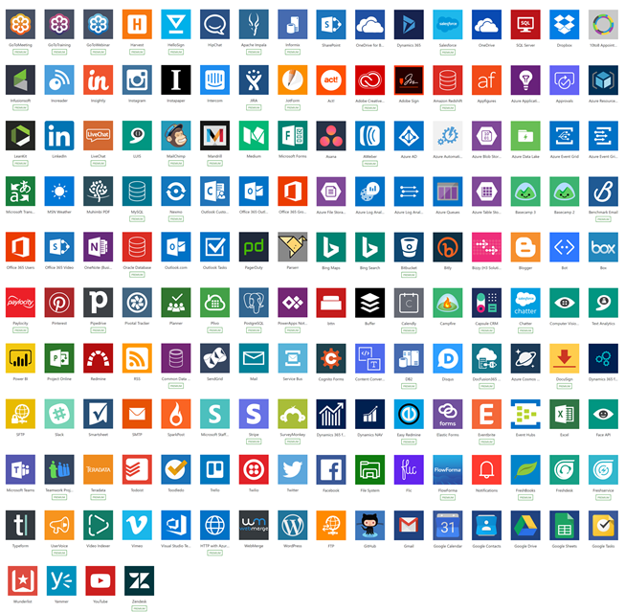
Connectors
Built-in connectivity to cloud services, files, databases, web APIs, etc. using public connectors
Seamless hybrid connectivity to on-premises systems via the on-premises data gateway
Connect to the service with your own security credentials
Open source
  https://github.com/microsoft/PowerPlatformConnectors
With custom connectors, you can extend the reach for your organization’s APIs to work with Power Platform
Over 1,000 published connectors

Slide 14
Why Dataverse for Code Apps
1
2
3
Relational tables
Built-in security
Shared with the platform
Tables, columns, lookups and choices model real business data.
Security roles control who can read, create, update and delete rows.
The same data serves canvas apps, model-driven apps, flows and reports.
Notes:
The pitch: your React code gets enterprise data and access control without building a backend.

Slide 15
How the pieces connect
React app
Power Apps SDK
Dataverse
→
→
TypeScript UI in your repo
Tables, rows and security
Auth and generated typed services
The app runs as the signed-in user, so Dataverse security roles decide what each person can see and change.
Notes:
Key point: no custom API layer. Generated services call Dataverse on behalf of the user.

Slide 16
Build workflow
Step | What you do | Where Copilot helps
1. Model | Create tables and columns in Dataverse | Draft the schema from requirements.md
2. Connect | Add the table as a data source with the pac CLI | Explain generated service types
3. Build | Call typed services from React components | Write forms, lists and hooks
4. Ship | Run locally, then push to your environment | Fix build errors, write scripts
Notes:
Exact pac code command names and flags change between CLI versions, so confirm them in the current Microsoft Learn docs before a demo.

Slide 17
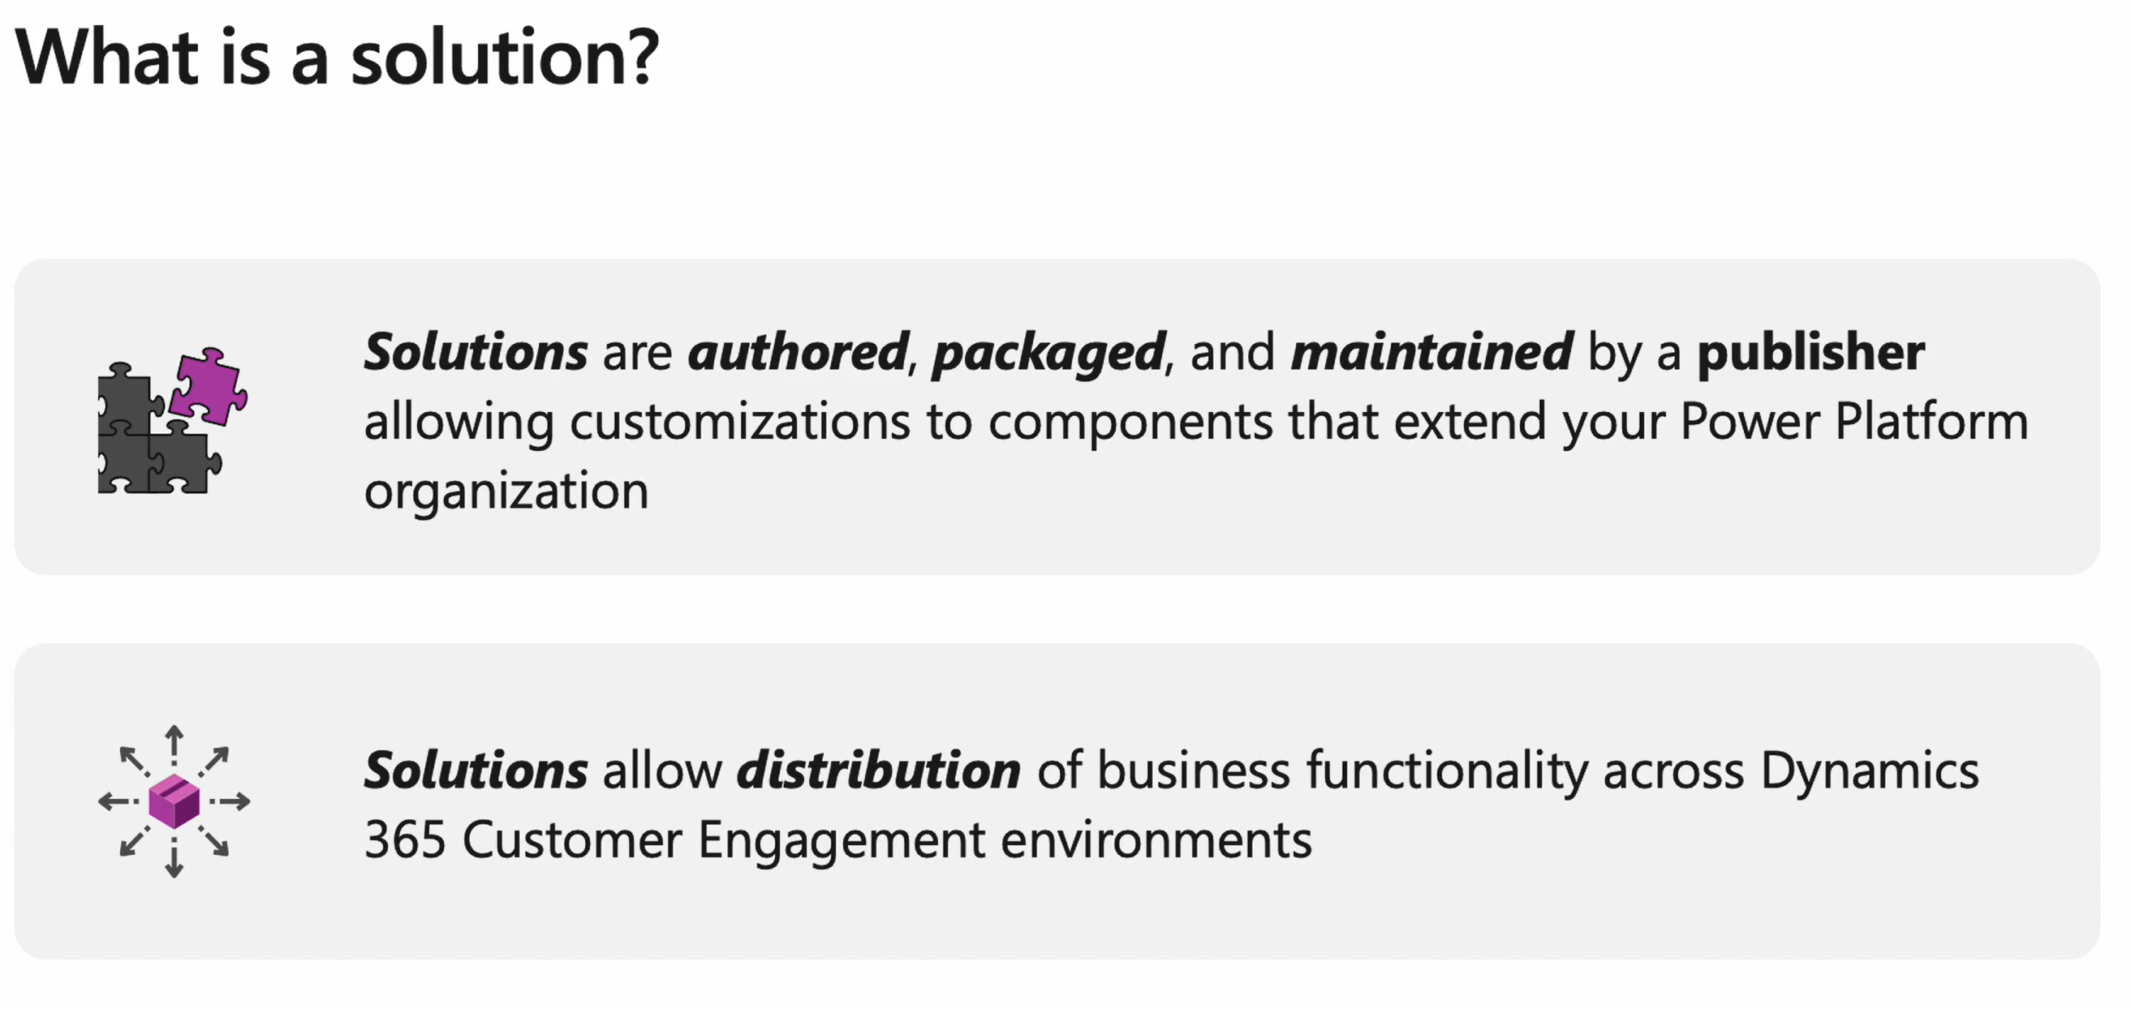
Solution
Notes:
https://learn.microsoft.com/en-us/training/modules/introduction-solutions/introduction

Slide 18

Demo
POWER PLATFORM
H1. Banking: model a customer-accounts schema
H2. Insurance: implement policy and claims CRUD with relationships
H3. Healthcare: enforce validation and row-level access
Notes:
Welcome. This deck walks through what you need before building your first Power Apps Code App, then the six commands that take you from a starter template to a deployed app.

